Slide 1

Project
(using spark streaming)
(Preferred language of code - scala)
Submitted to - Suresh kumar choudhary
Subject - Enabling Technology for Data Science(MBD-512)
Submitted by - Roopal jain (2017msbda007)

Slide 2
REAL TIME TWITTER ANALYTICS WITH SPARK STREAMING
ROOPAL JAIN
2017msbda007

Slide 3
Shortened
This project shows how to use spark streaming capabilities to analyze twitter data directly from Twitter’s sample stream.
we will demonstrate how to extract the most popular hashtags in Twitter's sample stream over the past few minutes.

Slide 4
Enviornment
1.you'll need a set of credentials from Twitter's Developer website to authenticate against Twitter's servers and access the sample stream. You can get these credentials from Twitter's Application Management site.
2.Spark Streaming includes a special library for Twitter access, called spark-streaming-twitter_2.10, which will be included in our pom.xml file as a dependency (along with spark-core_2.10 and spark-streaming_2.10).

Slide 5
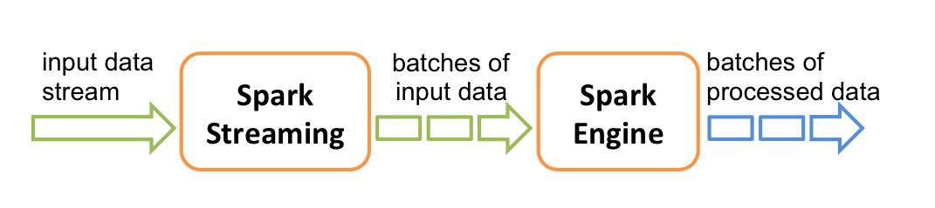
Spark streaming
Spark streaming is used to stream real time data from various sources like Twitter, Stock market and geographical systems and perform powerful analytics to help business.

Slide 6
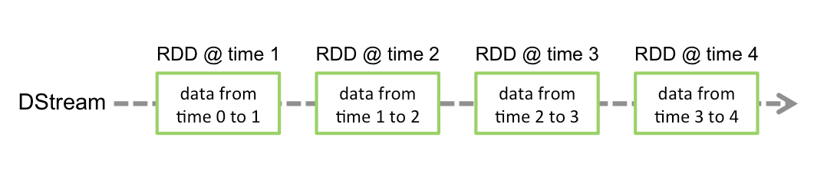
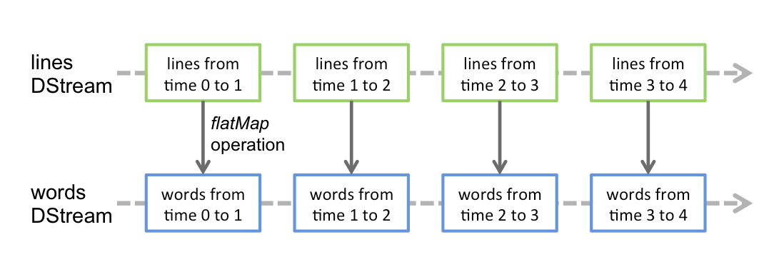
Dstream
A fundamental stream unit is DSTREAM which is basically a series of RDDs to process the real time data.
A DStream is represented by a continuous series of RDDs, which is Spark’s abstraction of an immutable, distributed dataset . Each RDD in a DStream contains data from a certain interval, as shown in the following figure.
the flatMap operation is applied on each RDD in the lines DStream to generate the RDDs of the words DStream. This is shown in the following figure.

Slide 7
Streaming context
It is main entry point for spark streaming.we have created streaming context with batch interval of 15 second.
val ssc = new StreamingContext(sc, Seconds(15))

Slide 8
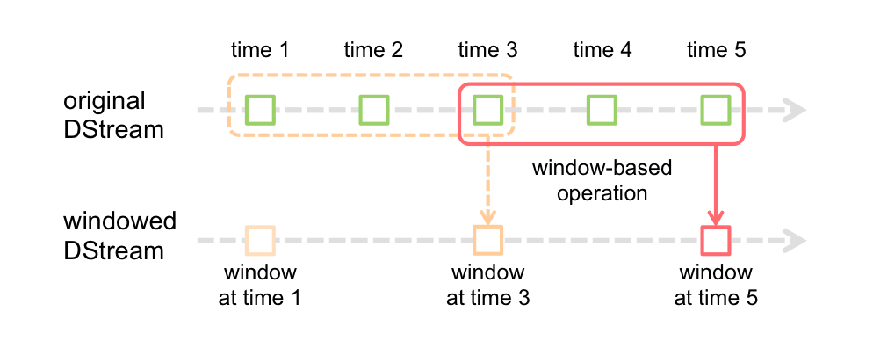
Window operations:
Spark Streaming also provides windowed computations, which allow you to apply transformations over a sliding window of data.
As shown in the figure, every time the window slides over a source DStream, the source RDDs that fall within the window are combined and operated upon to produce the RDDs of the windowed DStream.In this specific case, the operation is applied over the last 3 time units of data, and slides by 2 time units. This shows that any window operation needs to specify two parameters.
window length - The duration of the window (3 in the figure).
sliding interval - The interval at which the window operation is performed (2 in the figure).

Slide 9
Transformations of dstream
I have used flatMap and map function
Map: Return a new DStream by passing each element of the source DStream through a function .
flatMap:Similar to map, but each input item can be mapped to 0 or more output items.
Similar to that of RDDs, transformations allow the data from the input DStream to be modified. DStreams support many of the transformations available on normal Spark RDD’s

Slide 10
Output operations on Dstreams
foreachRDD(func) :
The most generic output operator that applies a function, , to each RDD generated from the stream. This function should push the data in each RDD to an external system, such as saving the RDD to files, or writing it over the network to a database. Note that the function is executed in the driver process running the streaming application, and will usually have RDD actions in it that will force the computation of the streaming RDDs.
Output operations allow DStream’s data to be pushed out to external systems like a database or a file systems. Since the output operations actually allow the transformed data to be consumed by external systems, they trigger the actual execution of all the DStream transformations (similar to actions for RDDs). Currently,i am using following output operation.

Slide 11
when code lines are executed, Spark Streaming only sets up the computation, it will perform when it is started, and no real processing has started yet. To start the processing after all the transformations have been setup, we finally call
ssc.start() // Start the computation ssc.awaitTermination() // Wait for the computation to terminate

Slide 12
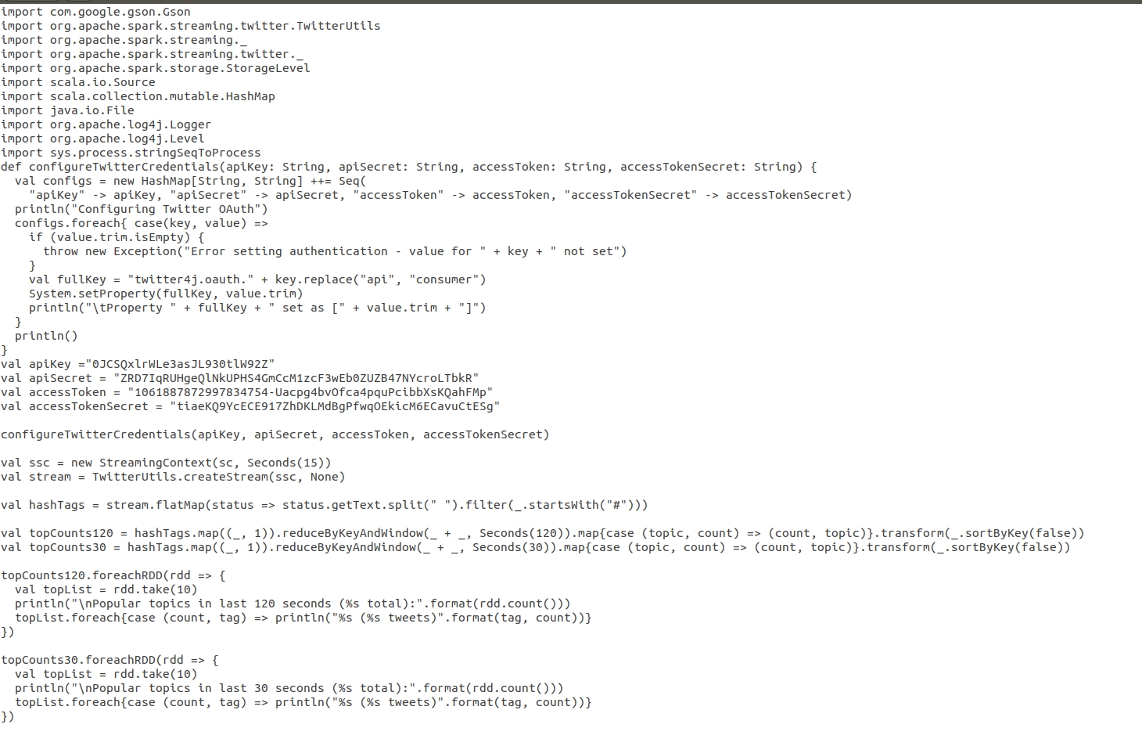
experiment

Slide 13
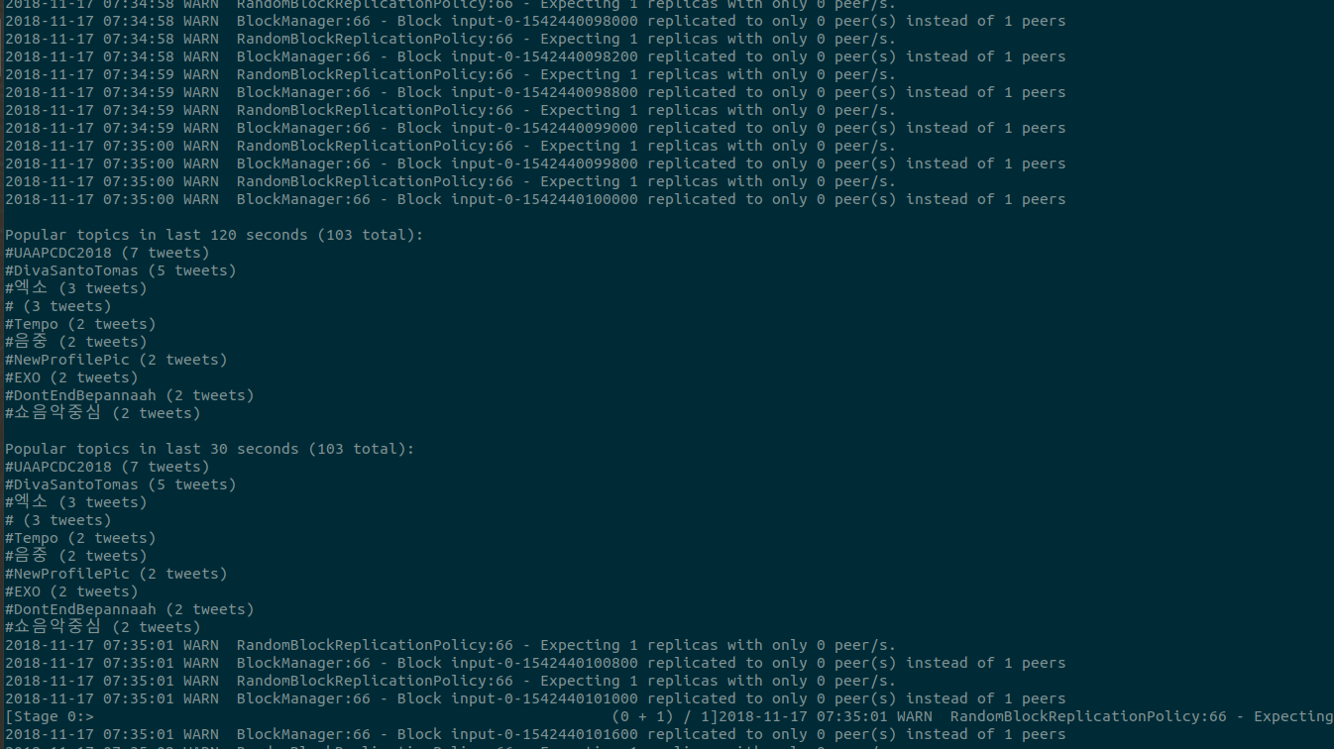
RESULTS-
We can see here popular topics of twitter in last 120 and 30 seconds.

Slide 14

Presented by :Roopal jain
REFERENCES: 1.Weather data analysis using Spark – An In-memory Computing framework
2.Scalable and Real-time Sentiment Analysis of Twitter Data(2016 IEEE 16th International Conference on Data Mining Workshops)
3.Streaming Big Data Analysis for Real-Time Sentiment based Targeted Advertising(International Journal of Electrical and Computer Engineering (IJECE))
4.Developing a Real-time Data Analytics Framework For Twitter Streaming Data(2017 IEEE 6th International Congress on Big Data)
5.STREAMING TWITTER DATA ANALYSIS USING SPARK FOR EFFECTIVE JOB SEARCH(Journal of Theoretical and Applied Information Technology)

